Slide 1
2018 BSides CTF in Review
Noemi Glaeser
USC Cybersecurity Club
31 January 2019

Slide 2
What is a CTF?
Capture the Flag cybersecurity challenge
Two main types:
“Jeopardy” style
Attack-Defense style
Upcoming online CTFs:
Feb 22-23: MITRE
April 13-15: PlaidCTF
BSides Charleston CTF: https://github.com/gabemarshall/eversec_ctf
Mix of both types

Slide 3
Flag for Signing Up
Free flag: passw0rd

Slide 4
Interview Questions
OSINT
Found on the EverSec website:
In an effort to more thoroughly vet our consultants, we've created a few interview questions to test your knowledge.
1. What was the specific vulnerability that led to the Equifax hack?
2. What is the feature that helps protect against buffer-overflow attacks by making it harder to guess where certain functions/processes are in memory?
3. This notation can be used to measure the complexity of an algorithm.
4. What is this function commonly called? https://pastebin.com/tQEu7CXA
(all answers can be submitted as flags, all lowercase, no spaces)

Slide 5
Interview Questions
OSINT
Found on the EverSec website:
In an effort to more thoroughly vet our consultants, we've created a few interview questions to test your knowledge.
1. What was the specific vulnerability that led to the Equifax hack? cve-2017-5638
2. What is the feature that helps protect against buffer-overflow attacks by making it harder to guess where certain functions/processes are in memory?
aslr
3. This notation can be used to measure the complexity of an algorithm.
bigo
4. What is this function commonly called? https://pastebin.com/tQEu7CXA
quicksort
(all answers can be submitted as flags, all lowercase, no spaces)
Notes:
ASLR = address space layout randomization

Slide 6
Twitter
OSINT
It’s always good to do some OSINT.
Found the EverSec Twitter
Flag in one of the tweets!
Flag: thx_4_the_f0ll0w

Slide 7
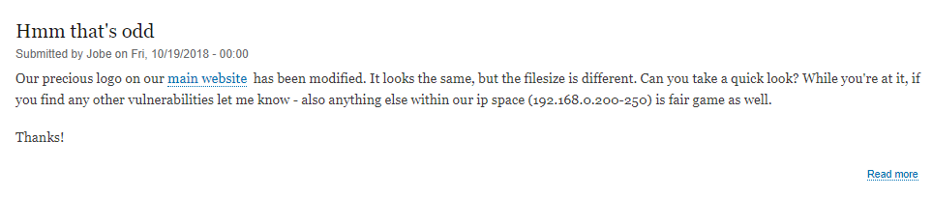
Hmm that’s odd
Steg (/OSINT)
http://eversec.rocks/

Slide 8
Hmm that’s odd
Steg (/OSINT)
Inspect website source to determine image path
wget [path]
Stegsolve

Slide 9
Hmm that’s odd
Steg (/OSINT)
Inspect website source to determine image path
wget [path]
Stegsolve
… do some OSINT: https://www.doyler.net/security-not-included/zsteg-easy-ctf-flags

Slide 10
Hmm that’s odd
Steg (/OSINT)
Inspect website source to determine image path
wget [path]
Stegsolve
… do some OSINT: https://www.doyler.net/security-not-included/zsteg-easy-ctf-flags
Flag: ilLs33yOuWH3nWeR3BOthL3553m0ti0n4l

Slide 11

Strange Files: nothing.png
Steg
The website asked us to figure out what some of these “strange files” in a .zip were.
https://incoherency.co.uk/image-steganography/#unhide

Slide 12

Strange Files: nothing.png
Steg
The website asked us to figure out what some of these “strange files” in a .zip were.
https://incoherency.co.uk/image-steganography/#unhide

Slide 13
Strange Files: nothing.png
Steg
The website asked us to figure out what some of these “strange files” in a .zip were.
https://incoherency.co.uk/image-steganography/#unhide
Convert to black and white (shoutout to James for
transcribing the QR code by hand), leads to this link:
http://qrs.ly/6t7r0zl

Slide 14
Strange Files: nothing.png
Steg
The website asked us to figure out what some of these “strange files” in a .zip were.
https://incoherency.co.uk/image-steganography/#unhide
Convert to black and white (shoutout to James for
transcribing the QR code by hand), leads to this link:
http://qrs.ly/6t7r0zl
Flag: y3t_an0th3r_qr_chal3ng3

Slide 15
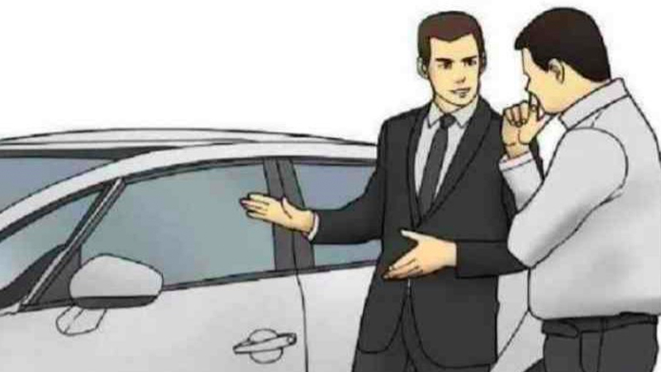
Strange Files: salesman.jpeg
Steg/Crypto
The website asked us to figure out what some of these “strange files” in a .zip were.

Slide 16
Strange Files: salesman.jpeg
Steg/Crypto
The website asked us to figure out what some of these “strange files” in a .zip were.
Let’s use Stegsolve again!

Slide 17
Strange Files: salesman.jpeg
Steg/Crypto
The website asked us to figure out what some of these “strange files” in a .zip were.
Let’s use Stegsolve again!
There’s more stuff after “End of Image”...? dGgxc19i NGJ5X2M0 bl9mMXRf czBfbXVj aF9jcnlw dDBfMW5f MXQ=

Slide 18
Strange Files: salesman.jpeg
Steg/Crypto
The website asked us to figure out what some of these “strange files” in a .zip were.
Let’s use Stegsolve again!
There’s more stuff after “End of Image”...? dGgxc19i NGJ5X2M0 bl9mMXRf czBfbXVj aF9jcnlw dDBfMW5f MXQ=
Base 64! https://base64decode.org

Slide 19
Strange Files: salesman.jpeg
Steg/Crypto
The website asked us to figure out what some of these “strange files” in a .zip were.
Let’s use Stegsolve again!
There’s more stuff after “End of Image”...? dGgxc19i NGJ5X2M0 bl9mMXRf czBfbXVj aF9jcnlw dDBfMW5f MXQ=
Base 64! https://base64decode.org
Flag: th1s_b4by_c4n_f1t_s0_much_crypt0_1n_1t

Slide 20
Strange Data: strange_numbers.txt
Crypto
The website asked us to figure out what some of these “strange data” in a .zip were.
00110100 00110010 00100000 00110110 00111001 00100000 00110100 01100101 00100000 00110011 00110100 00100000 00110111 00110010 00100000 00110101 00111001 00100000 00110011 00110010 00100000 00110100 00110001 00100000 00110010 00110100 00100000 00110110 00110011 00100000 00110100 00111001 00100000 00110100 00111001

Slide 21
Strange Data: strange_numbers.txt
Crypto
The website asked us to figure out what some of these “strange data” in a .zip were.
00110100 00110010 00100000 00110110 00111001 00100000 00110100 01100101 00100000 00110011 00110100 00100000 00110111 00110010 00100000 00110101 00111001 00100000 00110011 00110010 00100000 00110100 00110001 00100000 00110010 00110100 00100000 00110110 00110011 00100000 00110100 00111001 00100000 00110100 00111001
Recall that ASCII characters are 8 stored as 8 bits, and these are separated into chunks of 8. Maybe we can convert to ASCII?

Slide 22
Strange Data: strange_numbers.txt
Crypto
The website asked us to figure out what some of these “strange data” in a .zip were.
42 69 4e 34 72 59 32 41 24 63 49 49

Slide 23
Strange Data: strange_numbers.txt
Crypto
The website asked us to figure out what some of these “strange data” in a .zip were.
42 69 4e 34 72 59 32 41 24 63 49 49
Okay, before we give up on this approach, remember that hex numbers (given away by “4e”) can encode ASCII characters, so let’s try converting hex to ASCII.

Slide 24
Strange Data: strange_numbers.txt
Crypto
The website asked us to figure out what some of these “strange data” in a .zip were.
BiN4rY2A$cII

Slide 25
Strange Data: 1.txt
Crypto
The website asked us to figure out what some of these “strange data” in a .zip were.
NjRfWGExaTNmXzFhX2d1M19vNHB4

Slide 26
Strange Data: 1.txt
Crypto
The website asked us to figure out what some of these “strange data” in a .zip were.
NjRfWGExaTNmXzFhX2d1M19vNHB4
base64 > 64_Xa1i3f_1a_gu3_o4px

Slide 27
Strange Data: 1.txt
Crypto
The website asked us to figure out what some of these “strange data” in a .zip were.
NjRfWGExaTNmXzFhX2d1M19vNHB4
base64 > 64_Xa1i3f_1a_gu3_o4px
rot13 > 64_Kn1v3s_1n_th3_b4ck

Slide 28
Strange Data: dv.txt
Crypto
The website asked us to figure out what some of these “strange data” in a .zip were.
y3d{1337{d4jt3p{t3fx0ape

Slide 29
Strange Data: dv.txt
Crypto
The website asked us to figure out what some of these “strange data” in a .zip were.
y3d{1337{d4jt3p{t3fx0ape
We had no idea

Slide 30
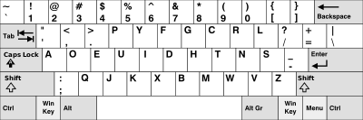
Strange Data: dv.txt
Crypto
The website asked us to figure out what some of these “strange data” in a .zip were.
y3d{1337{d4jt3p{t3fx0ape

Slide 31
Strange Data: dv.txt
Crypto
The website asked us to figure out what some of these “strange data” in a .zip were.
y3d{1337{d4jt3p{t3fx0ape
DVORAK! https://www.branah.com/dvorak

Slide 32
Strange Data: dv.txt
Crypto
The website asked us to figure out what some of these “strange data” in a .zip were.
y3d{1337{d4jt3p{t3fx0ape
Flag: t3h_1337_h4ck3r_k3yb0ard

Slide 33
Other Flags
Blake and Adam got a bunch:
d3 - ENdP01ntPr0t3cti0N - 300 pts
L0gh4x - 75 pts
Josh and Brian Hull: rc4.js.txt
Clay: some SQL injection

Slide 34
Unsolved
strange-files
ez-crackme
wrblr
slky.smooth
strange-data
2.txt
xor.js.txt
pshhh.txt
nothing2see

Slide 35
Strange Files: wrblr.tar
?
The website asked us to figure out what some of these “strange files” in a .zip were

Slide 36
Strange Files: ez.tar
Crypto
The website asked us to figure out what some of these “strange files” in a .zip were.
Unzips to file ez-crackme

Slide 37
Strange Data: 2.txt
Crypto
The website asked us to figure out what some of these “strange data” in a .zip were.
1,3-F@<45G?YqK;1LG2Z@s)fJ

Slide 38
Strange Data: pshhh.txt
?
The website asked us to figure out what some of these “strange data” in a .zip were.

Slide 39
Strange Data: pshhh.txt
?
The website asked us to figure out what some of these “strange data” in a .zip were.
Looks like a shell script, tried various Unix scripting languages (`/bin/sh pshhh.txt`, `/bin/zsh pshhh.txt`, etc.), Powershell, wasted a lot of time on Perl versions
Filename is probably a hint
May be related to this: https://github.com/pglass/pshhh

Slide 40
Questions?

